Slide 1

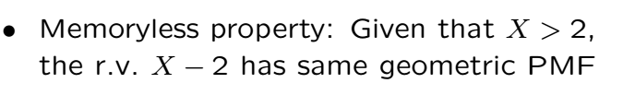
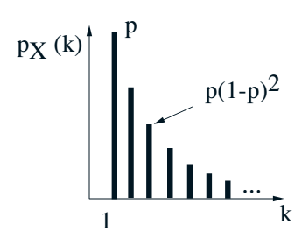
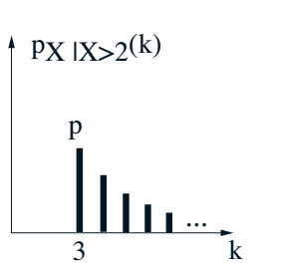
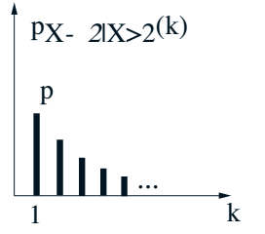
Memoryless Geometric

Slide 3
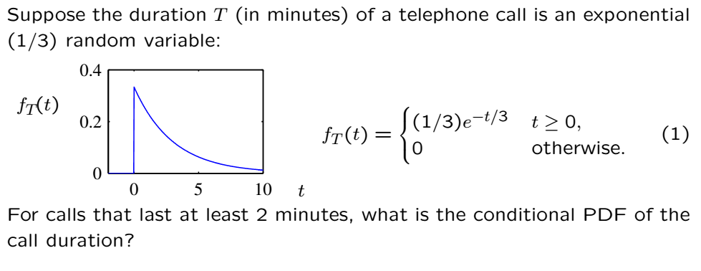
Memoryless Exponential
Exponential is the continuous analogue of the geometric

Slide 4
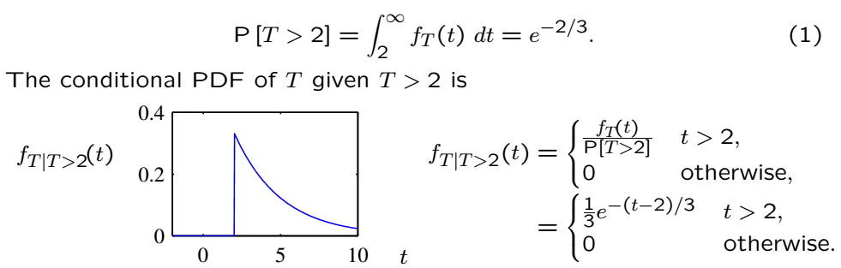
Memoryless Exponential

Slide 5
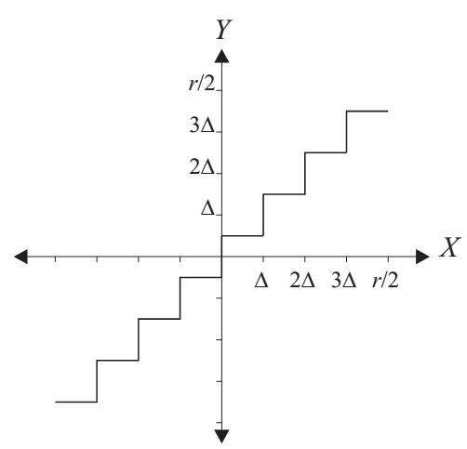
Quantizer Example
X is continuous, Y is discrete to convert into bits
A rounding operation that involves loss of info

Slide 6


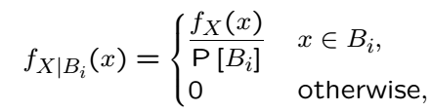
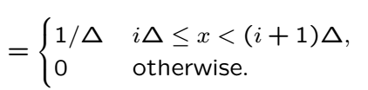
Quantizer Example Continued
If X is uniform over (-r/2,r/2) and we are given Y
What is the conditional distribution of X given Y?
Knowing the value of Y just means X is in a certain region:

Slide 7
Acknowledgements and Citations
Parts of these slides are adapted from the following resources:
Power Point Lecture Slides for the Textbook http://bcs.wiley.com/hebcs/Books?action=index&bcsId=8676&itemId=1118324560
John Tsitsiklis. 6.041 Probabilistic Systems Analysis and Applied Probability, Fall 2010. (Massachusetts Institute of Technology: MIT OpenCourseWare),http://ocw.mit.edu (Accessed 13 Apr, 2015). License: Creative Commons BY-NC-SA

